Slide 1
Virtual Machines
Jochem Arends

Slide 2
Little Computer 3
an educational architecture
minimal instruction set (15 unique opcodes)
8 general purpose registers (R0-R7)
registers
conditionon codes

Slide 3
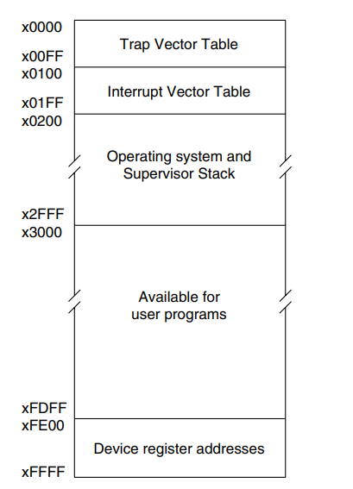
Memory
16-bit addressable memory
little-endian
memory mapped IO

Slide 4
Input Output

Slide 5
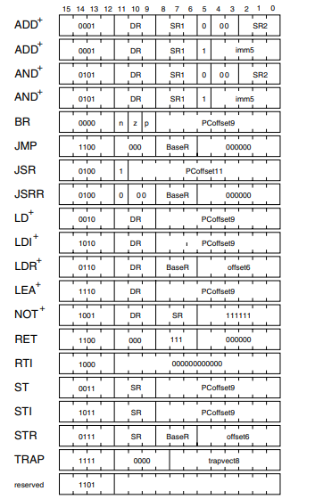
Instruction Encoding

Slide 6
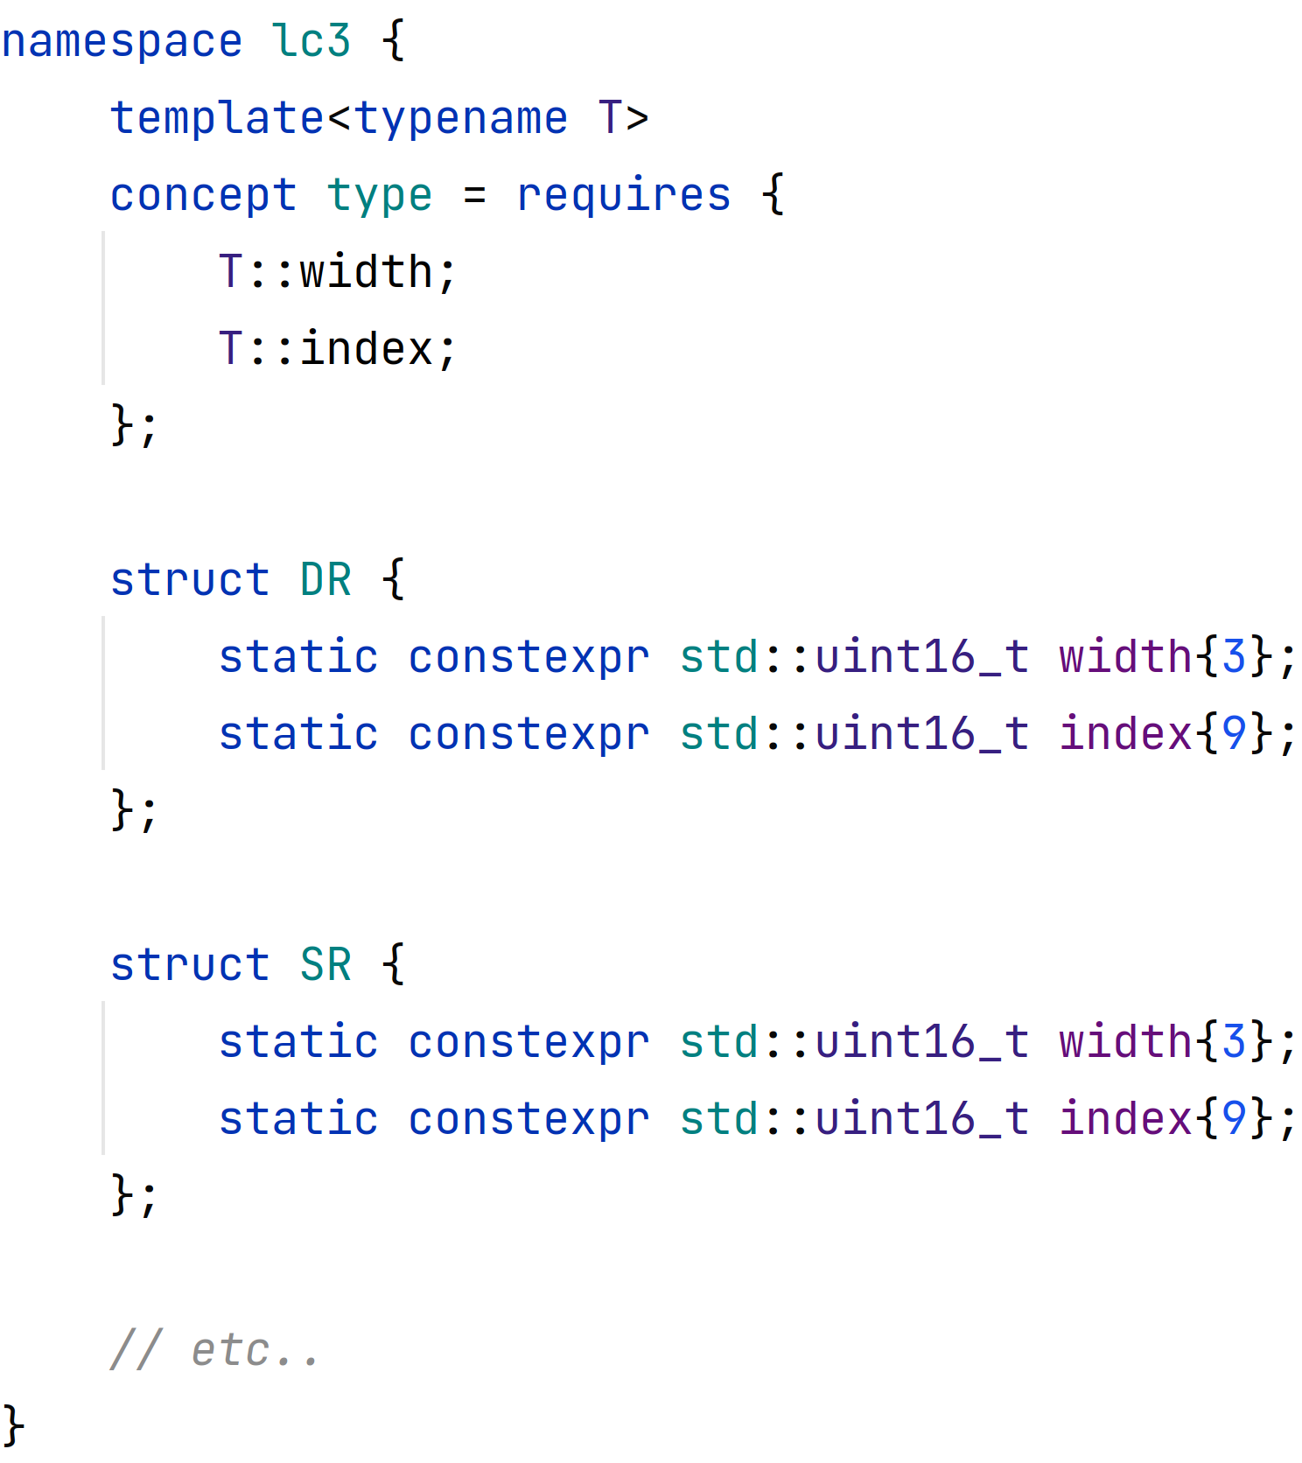
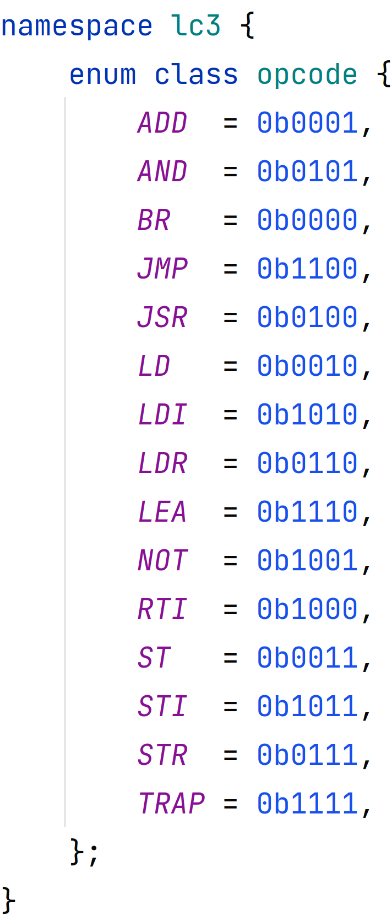
Instruction Decoding

Slide 7
Instruction Encoding
each component of an encoding can be represented by a width and a index (starting at the the LSB)

Slide 8
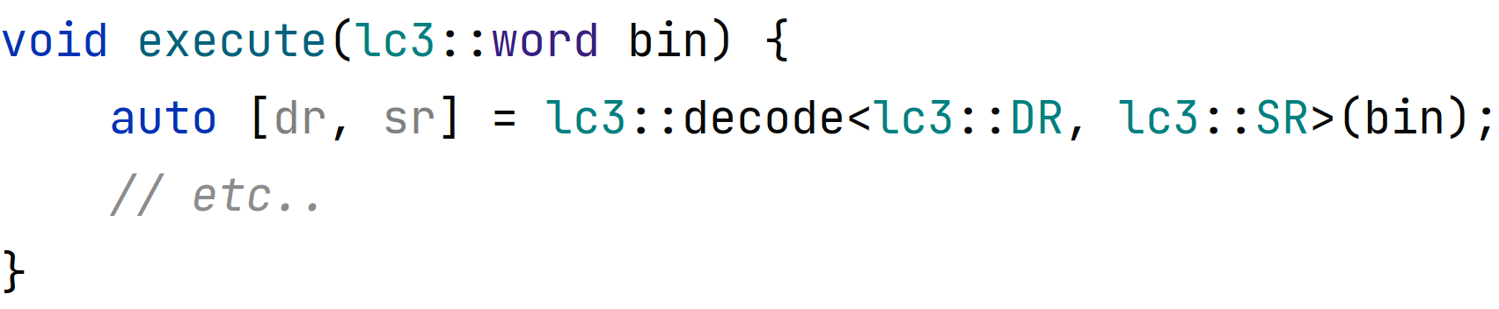
Instruction Encoding
each part of a can be represented by a width and a index (starting at the the LSB)

Slide 9
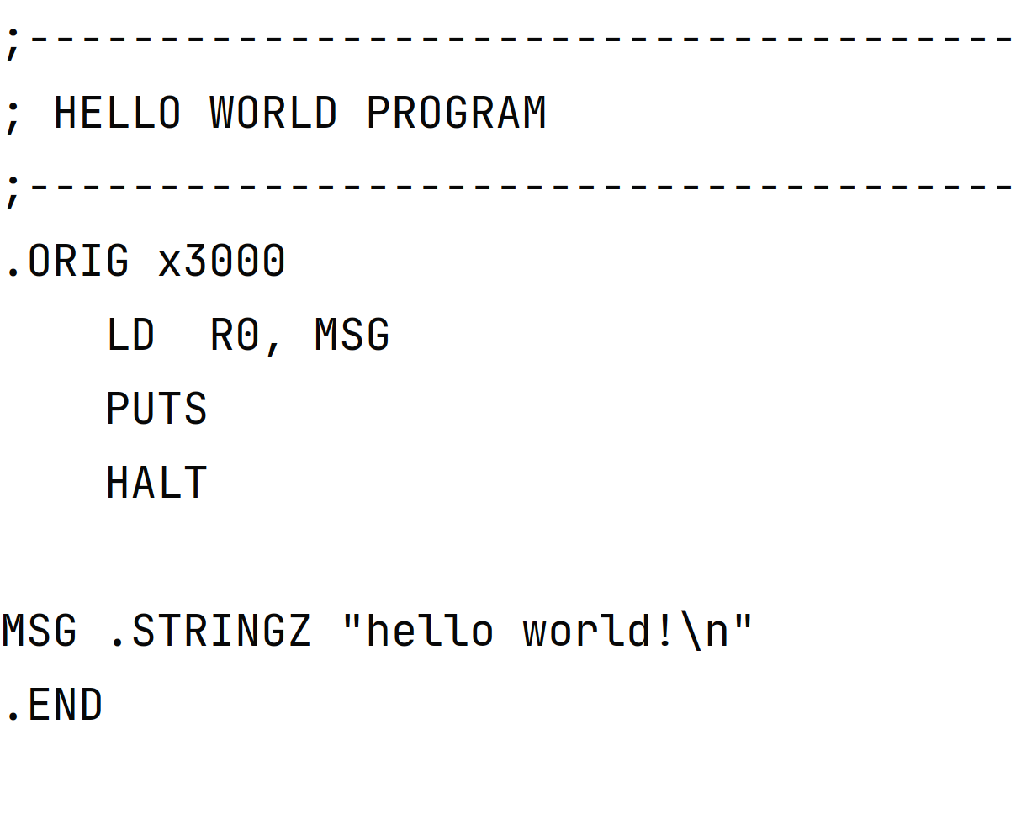
Assembling
A hello world

Slide 10
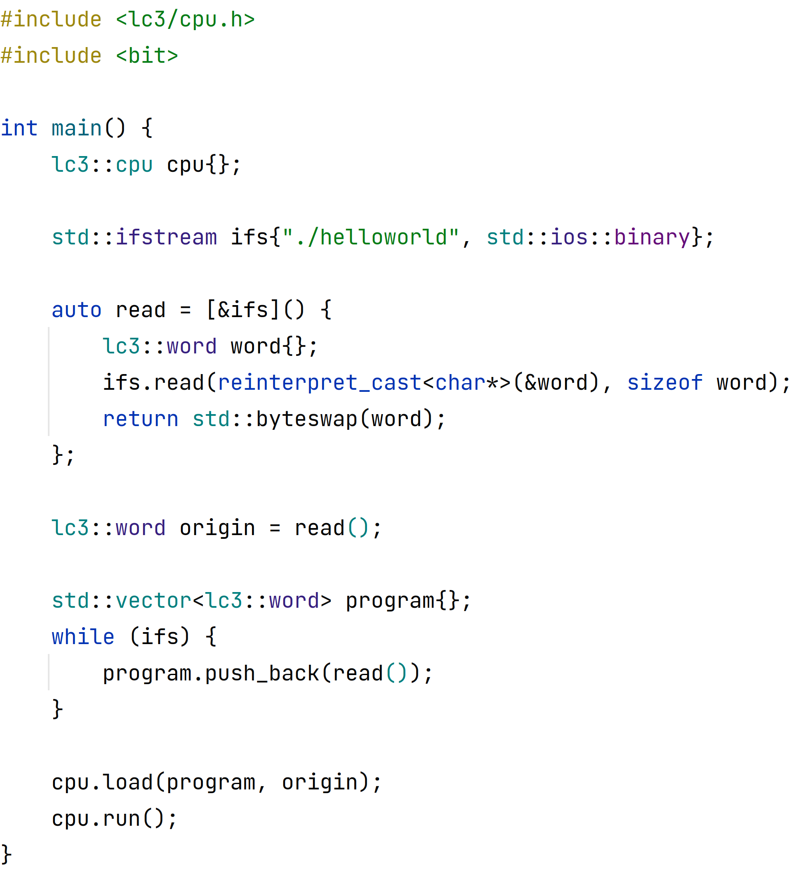
Loading Object Files
1st word is where program should be loaded.
rest contains instructions
big-endian to little-endian

Slide 11
Limitations
comparing or subtracting
bit shifting
text-based input/output
unsigned data

Slide 12
Resources Used
LC-3 details: https://www.jmeiners.com/lc3-vm/supplies/lc3-isa.pdf
assembler: https://wchargin.com/lc3web/

Slide 13
Questions?
;--------------------------------------
; HELLO WORLD PROGRAM
;--------------------------------------
.ORIG x3000
LD R0, MSG
PUTS
HALT
MSG .STRINGZ "hello world!\n"
.END

